Slide 1
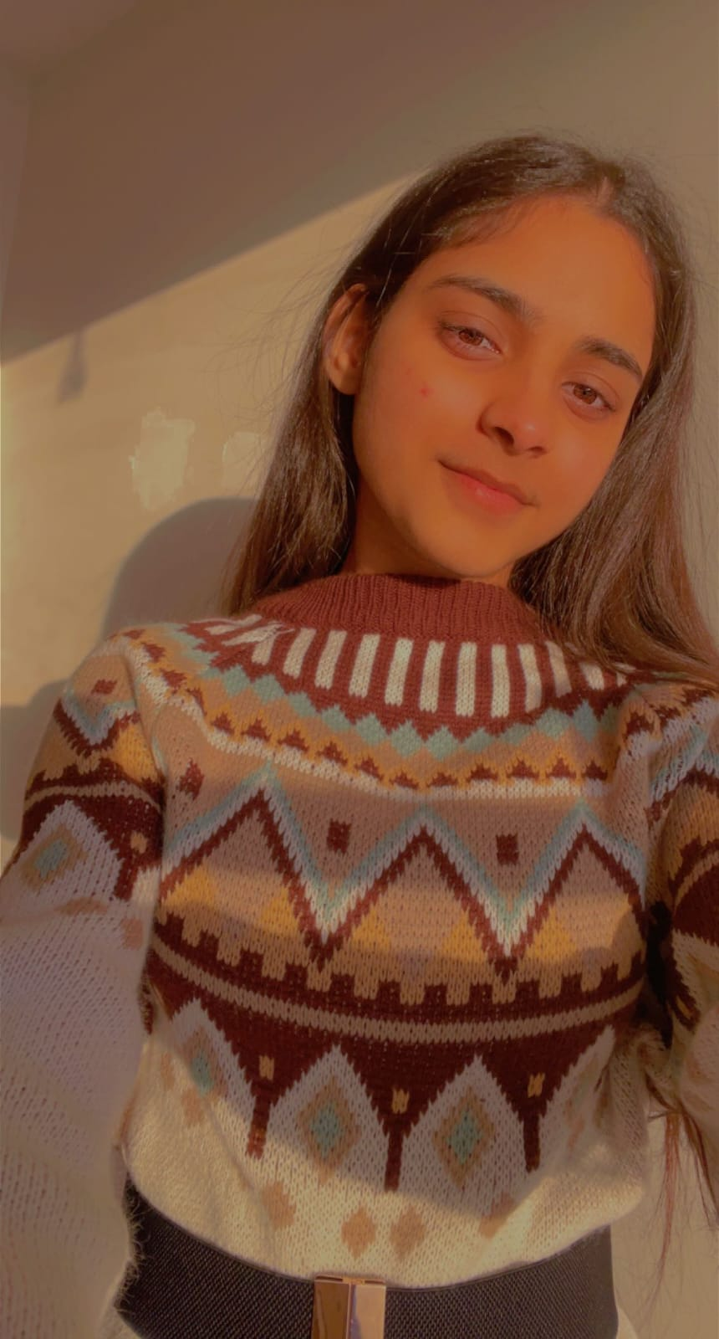
Yashsvi Designs
A website build with HTML, CSS, Js and TypeScript for COMP 2112. A mini-portfolio website that describe what I do.
Adv Client-Side-JavaScript -01
COMP 2112-22F-11342
Yashsvi - 200490302
Notes:
Line spacing + Page numbers

